Slide 1

Team Name : CodeSilver AI
Team Leader Name : Sudarshanam Yessasvini
Problem Statement :Hospitals suffer from a hidden operational gap where clinicians document care using clinical language while hospital systems require operational and billing language.
This disconnect leads to claim denials, incorrect admission status, documentation gaps, and delayed prior authorizations — increasing financial loss and workflow inefficiency.
Existing AI solutions focus on patient education, chatbots, or clinical summarization, but none address real-time translation between clinical intent and operational execution.

Slide 2

Brief about the Idea:
CodeSilver is an ambient AI system that silently translates clinical discussions into structured operational insights for utilization review and revenue cycle teams.
Instead of interrupting doctors with alerts or forcing workflow changes, the system listens to clinical text (synthetic/public data in prototype) and generates:
DRG suggestions
Documentation gap flags
Admission status insights
Prior authorization indicators
This creates a bridge between medical decision-making and hospital operations without increasing clinician cognitive load.

Slide 3
Your solution should be able to explain the following:
How different is it from any of the other existing ideas?
Most healthcare AI tools:
Target patients (education bots)
Assist doctors directly (scribes, summarizers)
Automate scheduling or workflows
CodeSilver targets the operational layer, which is largely ignored.
Key differentiation:
It does not replace documentation or provide clinical advice.
It translates existing clinical language into operational intelligence.
It operates passively without alerts or extra clicks.

Slide 4
How will it be able to solve the problem?
CodeSilver analyzes clinical narratives using an LLM trained on public datasets and CMS rules.
It extracts structured signals such as:
Suspected DRG categories
Missing severity documentation
Observation vs inpatient status risks
Prior authorization triggers
These outputs help operational teams intervene earlier, reducing downstream billing errors.

Slide 5
USP of the proposed solution:
Zero-interruption AI design
Operational intelligence instead of clinical decision support
Built entirely using public/synthetic datasets
Focus on revenue cycle efficiency rather than clinical automation

Slide 6
Features Offered by the Solution
Core Features
Clinical-to-operational translation engine
Documentation gap detection
Admission status risk scoring
DRG mapping (prototype)
Prior authorization awareness
Demo Features (Hackathon MVP)
Two-column UI: Clinical text vs Operational summary
Real-time LLM generation
Synthetic evaluation dashboard

Slide 7
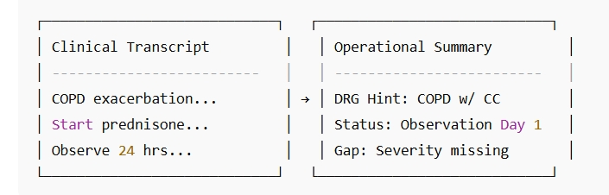
List of features offered by the solution

Slide 8
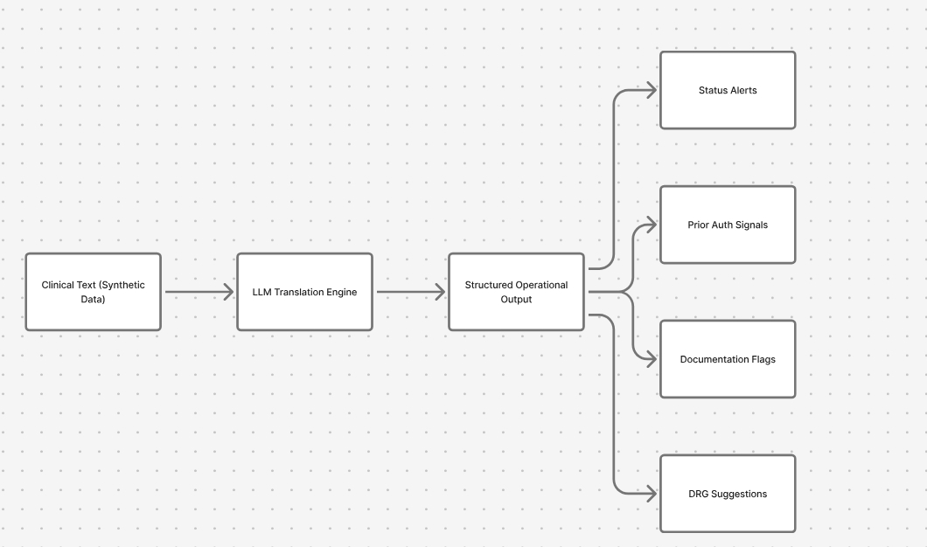
Process flow diagram or Use-case diagram

Slide 9
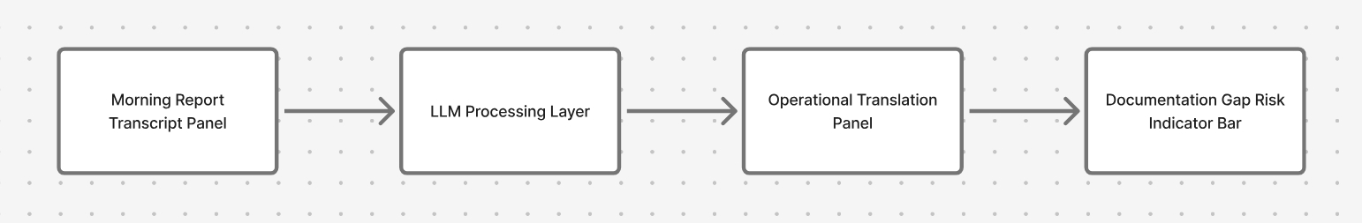
Wireframes/Mock diagrams of the proposed solution (optional)

Slide 10
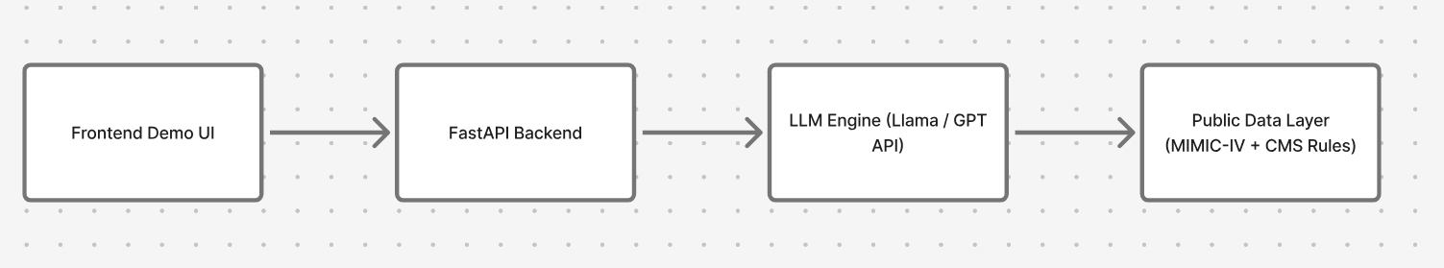
Architecture diagram of the proposed solution:

Slide 11
Technologies to be used in the solution:
Python
FastAPI
Llama 3 / OpenAI API (prototype)
Public CMS datasets
MIMIC-IV synthetic clinical notes
Docker (optional deployment)
React (optional frontend demo)

Slide 12
Estimated implementation cost (optional):
Hackathon prototype cost is minimal:
Open datasets: Free
Open-source models: Free (local inference)
Cloud inference (optional): Low-cost API usage

Slide 13
Add as per the requirements for the hackathon:
Safety & Limitations:
Uses synthetic and publicly available datasets only.
Not a clinical decision support system.
No automated billing actions.
Outputs require human review.
Dataset bias possible due to ICU-heavy training data.
Prototype only — not validated in real hospital workflows.
Short Pitch :LineCodeSilver is not another chatbot.It is a silent AI translator that converts clinical intent into operational intelligence — reducing claim denials without adding extra work for doctors.

Slide 14


